Slide 1
ADVENTURE WORKS
KPI OVERVIEW, FY2004
Notes:
The goal of this presentation is…

Slide 2
CONTENTS
FY2004 KPI Overview in Numbers
Financial Trend Analysis
Order Volume and Pricing Trends
Profitability Challenges in Offline Channel
Summary
Next Steps: Balancing Fast Growth and Profitability
Q&A
Notes:
FY2004 performance remained strong and balanced, with top- and bottom- line resultes exceeding expectations.

Slide 3
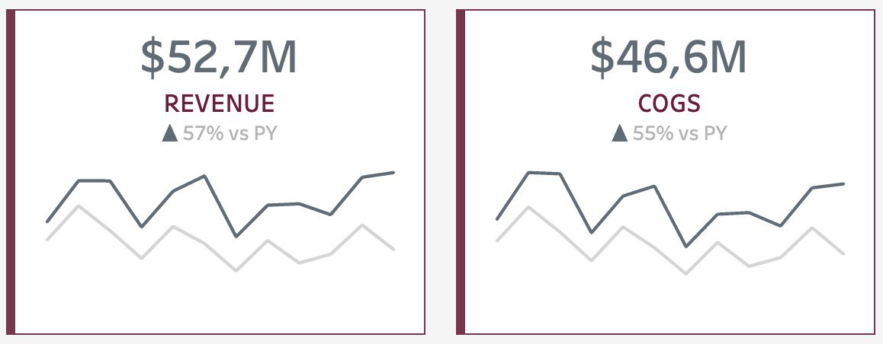
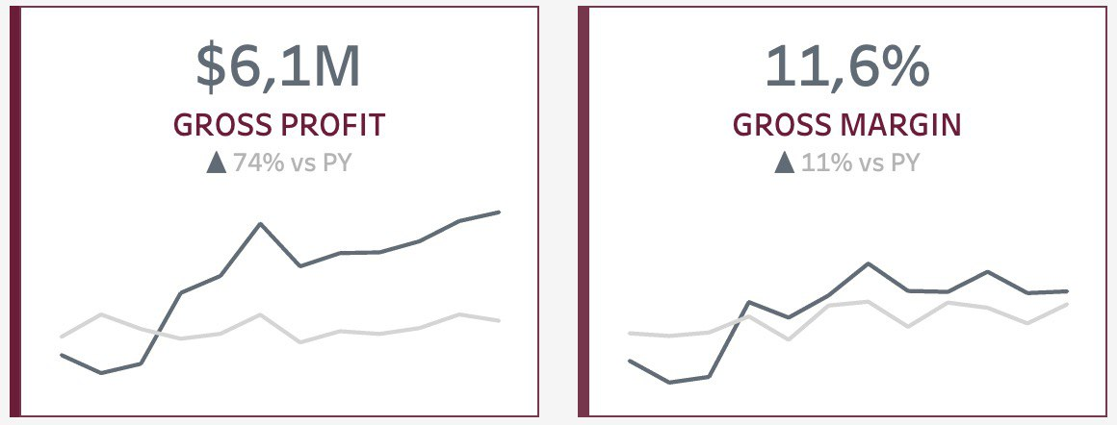
KPI OVERVIEW IN NUMBERS | FY2004, all regions Financial Trend Analysis
Positive growth in revenue and profitability
Rise in Cost of Goods Sold, possibly impacting profitability
Notes:
Revenue increased steadily to $109.7 million, while gross profit rose positively to $12.5 million. However, a rise in operational expenses saw Cost of Goods Sold escalate to $97.2 million. This increase led to a decrease in Gross Margin to 11.4%, signalling a decline in profitability due to heightened production costs. Revenue Growth: The consistent growth in revenue to $109.7 million indicates positive market traction and sales performance over time.
Gross Profit Increase: Despite the revenue growth, the rise in gross profit to $12.5 million showcases improved efficiency in production or sales processes.
Cost of Goods Sold: The notable increase to $97.2 million suggests higher operational expenses, possibly impacting profitability.
Gross Margin Decline: The decrease to 11.4% indicates a decline in profitability, highlighting the pressing need to address rising production costs.

Slide 4
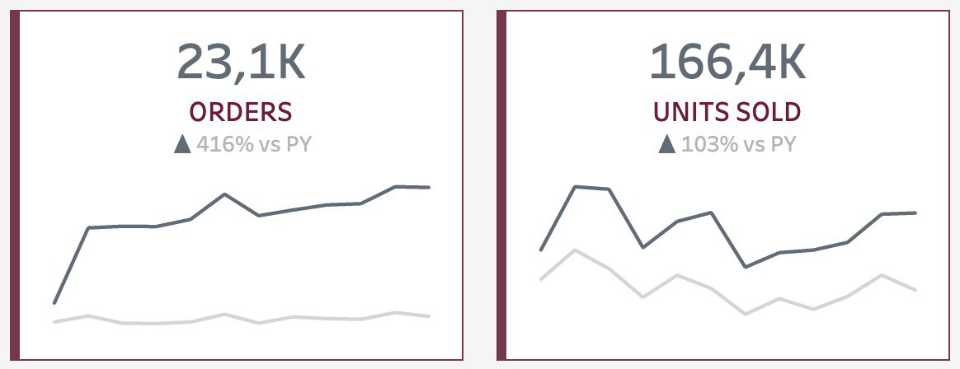
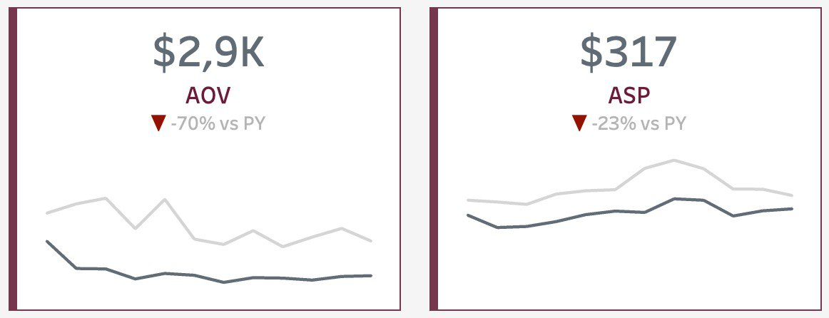
KPI OVERVIEW IN NUMBERS | FY2004, all regions order volume and pricing trends
Significant surge in customer activity:
Orders increased by 416%
Total Units Sold doubled due to volume discounts in Offline channel
Drop in AOV and ASP, indicating changes in:
customer behaviour
pricing strategies towards lower-priced items
product mix (introduction of cheaper products like Accessories and Clothing Online)
Notes:
During the AOV drop period, cheaper products like accessories and clothing were added to online sales. This aligned with sales showing an increase but for lower-priced products.
The company actually included ACC and clothing to online, so they included more product that are cheaper. Also in sales reason price also shows up. Sales increased but for very small price products.
Total Orders grew to 30,389, reflecting heightened customer activity. Despite this increase, Average Order Value (AOV) dropped to $4.6k, indicating reduced spending per order. However, Total Units Sold surged to 272.7k, showing an upward trend in product movement. The Average Sales Price (ASP) declined to $402, highlighting a decrease in the average price per unit sold.
Order Volume Growth: The increase in total orders to 30,389 reflects heightened customer engagement and increased market demand.
Average Order Value (AOV) Decline: The drop in AOV to $4.6k might suggest a shift in customer spending behavior or pricing strategies.
Total Units Sold Increase: The surge to 272.7k units sold signifies robust product movement and sales traction.
Average Sales Price (ASP) Decline: The decrease to $402 per unit sold indicates a reduction in the average price per product, possibly impacting revenue per sale

Slide 5
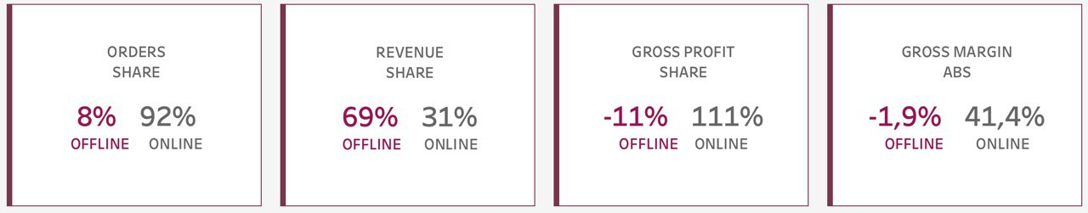
KPI OVERVIEW IN NUMBERS | FY2004, all regions profitability Challenges in offline channel
- Online (92% of all orders) contributed 31% to total revenue - Offline (only 8% of all orders) drove a substantial 69% of total revenue
- Online is the only driver of profitability with a significant margin of 41.4%
- Offline incurred gross profit losses, resulting in a negative margin of -1.9% and posing profitability challenges
Notes:
Offline – lower prices and substantial discounts compare to Online

Slide 6
KEY takeaways
Costs Impact on Profitability
2. Changing Customer & Pricing Dynamics
3. Profitability Challenges in Offline
Notes:
Costs Impact Profitability: COGS increased, potentially impacting overall profitability.
Changing Customer & Pricing Dynamics: AOV and ASP declined, signaling shifts in customer behavior and pricing strategies toward lower-priced items. Introduction of cheaper products online may have influenced this change.
Offline Profitability Challenges: Gross profit losses in the offline channel resulted in a negative margin of -1.9%, indicating challenges in achieving profitability.

Slide 7





Next steps: Balancing growth and profitability
Cost Management
Pricing Strategy Refinement
Evaluate and optimize cost efficiency to mitigate the impact of rising COGS on profitability
Review and adjust pricing strategies in Offline
Focus on value propositions while maintaining competitive pricing
Product Mix Alignment
Offline Channel Restructuring
Evaluate KPI on Product level
Reassess the product mix, ensuring a balance between high and low-priced items across channels
Implement strategies to enhance profitability and achieve positive margins in Offline sales
Notes:
These recommendations focus on cost management, pricing strategies, product mix adjustments, and targeted improvements in the offline channel to address the highlighted challenges.
Our Commitment: Establishing a Sustainable Business Model -> Balancing (fast revenue) Growth and Profitability
Despite revenue growth, the decline in gross margin calls for a focused strategy to balance rapid expansion with maintaining profitability.
Addressing the increase in Cost of Goods Sold is crucial to improving profitability. 1. Gross Profit Margin Focus: Aiming for a 20% increase in gross profit margin by optimizing pricing and promotional strategies within our offline channel
Revenue Diversification: Targeting a 60% overall revenue increase across both channels to foster a balanced growth trajectory
Customer Value Enhancement: Driving a 30% increase in Average Order Value (AOV) to enhance overall profitability
Operational Efficiency: Identifying cost-saving opportunities and enhancing operational efficiencies to align with our growth trajectory

Slide 8
Q&A

